Slide 1
ES 200: Autumn 2020
Environmental Studies : Science and Engineering
Module C: Solid Waste Management
Prof. Tabish Nawaz (Module C)
(tnawaz@iitb.ac.in)
Environmental Science and Engineering Dept.,
IIT Bombay
* Instructor In-Charge
(vsethi@iitb.ac.in)

Slide 2
Module C
Solid Waste Management
Lecture-3 Topics
Analysis of solid waste management systems
Material balance approach
Functional elements: MSW Collection
Hauled-container system
Stationary-container system

Slide 3

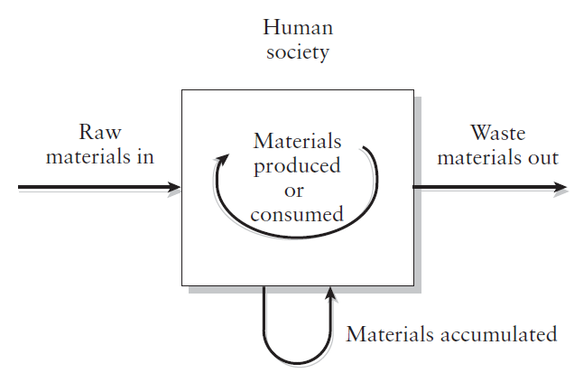
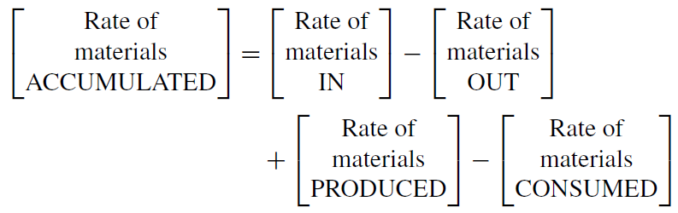
Material Balance Approach for the flow of materials through human society
Matter can neither be created or destroyed
The mass of inputs, whether to a process, an industry, or a region, must balance the mass of outputs as products, emissions, and wastes, and it must account for any changes in the accumulated mass.
Notes:
Material balance can be formulated for mass, and if density remains constant, it can be formulated for volume Steady-state assumption: Rate of material accumulation = 0
Conservative substance: No material is being produced or being consumed inside the system With these two assumptions, we get that the rate of material input = the rate of material output

Slide 4
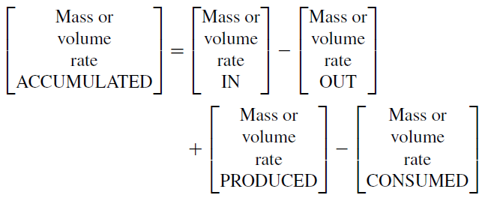
Guidelines for applying material balance approach
Draw the system diagram, and include all flows (inputs and outputs).
Define control volume around the component that is being studied.
Decide what material is to be balanced (volumetric or mass flow rate).
Write the generic material balance equation and solve for the variable.
If more than one variable is unknown, repeat the procedure, using a different control volume or a different material for the same control volume.

Slide 5
Example Problem for Material Balance
Q) Mr. and Mrs. Smith bring into their apartment 50 kg of consumer goods (food, magazines, clothes,…, and the associated packaging material) in an average week. Of this amount, 50% is consumed as food. Half of the consumed food is used for biological maintenance and ultimately released as CO₂; the remainder is discharged to the sewer system. The Smith’s started recycling 25% of the solid waste that is generated, and approximately, 1 kg accumulates in the house. What is the amount of solid waste they place in the apartment community dustbin?
Step 1: Draw a mass balance diagram for the house (define control volume) and identify the known and unknown inputs and outputs.
Here we are balancing mass flow rates
Control Volume
Consumed as Food (25 kg/week)
Consumer Goods
50 kg/week
Accumulation
Solid Waste (? kg/week)

Slide 6
Example Problem for Material Balance
Step 2: Write the mass balance equation for the control volume
Generic equation for material balance
accumulation in house = input – output as solid waste + 0 – consumed as food
Step 3: Identify all terms in the above equation per week
Accumulation in house = 1 kg
Input = 50 kg
Output as solid waste = ?
Consumed as food = half of the input = 0.5 x 50 kg = 25 kg
From the mass balance equation, 1 = 50 kg – ? – 25 kg → ? = 24 kg
However, as the Smith’s recycle 25% of generated solid waste, only 75% makes its way to the dustbin → 0.75 x 24 kg = 18 kg

Slide 7
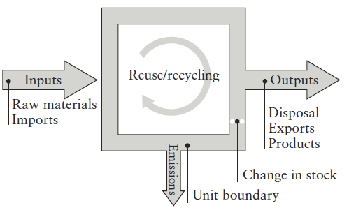
Large-Scale Applications of material balance approach
Animal manures release about 40% of UK’s methane → Construction of manure digesters that allow for energy recovery from methane.
Helps identify where valuable recyclable resources are leaking out of the economic system, such as whether resources are being exported as product or lost as waste.
Paper and board industry in UK uses 7.2 mt of pulp each year, of which 4.9 mt is derived from waste paper (a recycling rate of 69%, increased from 59% in 1996).
Berthourex, B. M., and D. F. Rudd. 1977. Strategy for Pollution Control. New York: John Wiley & Sons.

Slide 8
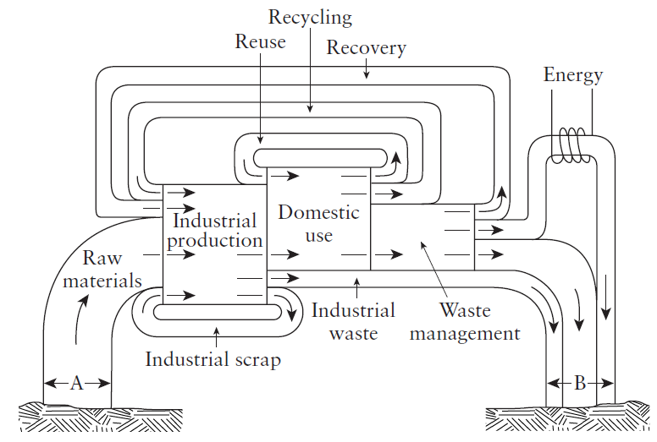
Graphical representation of the flow of materials through human society.
Vesilind, P.A., Morgan, S.M., and L. G. Heine. Introduction to Environmental Engineering. 3rd ed., Stamford: Cengage Learning
Notes:
The width of the bands indicates the mass rate of flow.
All materials originate from earth, and the amount of material extracted is “A”.
These are the raw materials, that feed industry and are fed into the manufacturing sector for the production of useful goods.
Some extracted materials become industrial waste, that must be disposed of into the environment.
Some materials become industrial scrap and can be used by the same industry or shipped to some other industry through a waste exchange.
The materials in the form of manufactured goods flow from industry to the public.
The public uses these materials and then discards some of them.
The material the public chooses to classify as waste becomes domestic waste, and this material is given to the waste management sector.

Slide 9
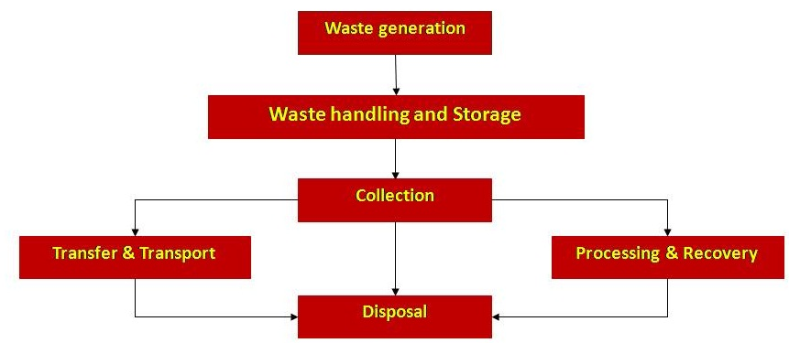
Functional elements of a solid waste management system

Slide 10
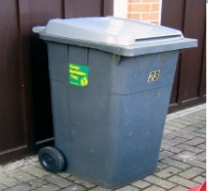
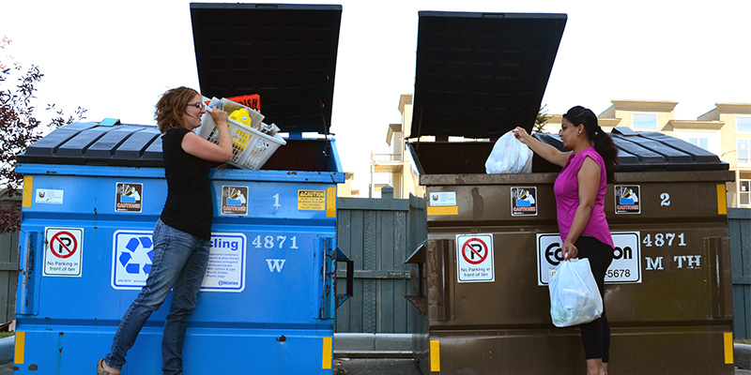
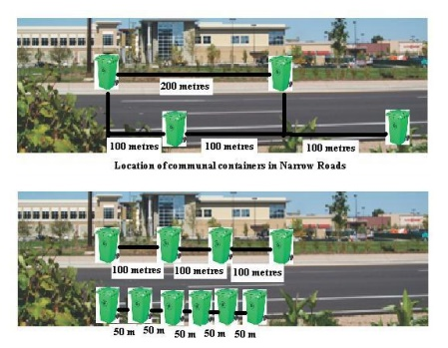
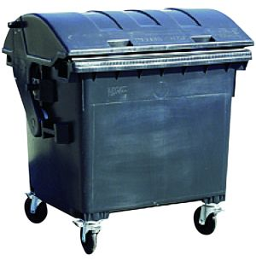
Different Types of On-Site Handling and Storage Containers

Slide 11
Functional elements of a solid waste management system

Slide 12
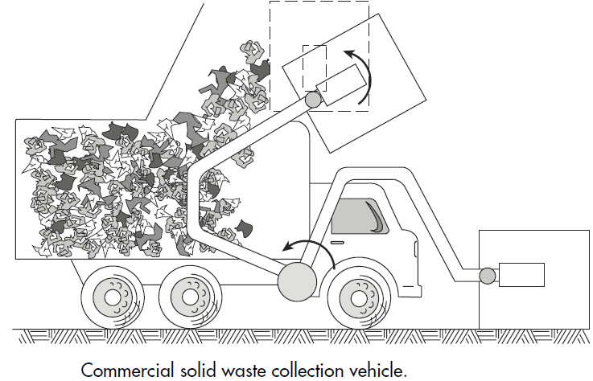
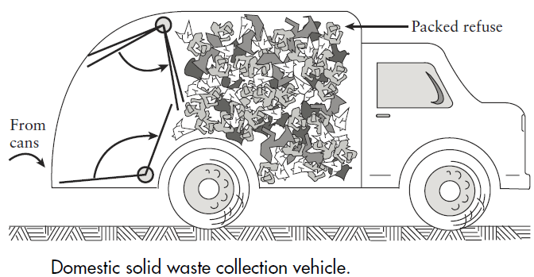
Solid Waste Collection
Type of collection service (curb, alley, backyard)
Type of collection system (Hauled or Stationary container)
Types of collection vehicles
Collection routing (discussed in appendix for lecture-3)
Collection refers to the gathering of solid wastes from residential, commercial, institutional, public parks, and industrial areas.
Transportation refers to the hauling of solid wastes to relatively far distances from the collection areas or transfer station.

Slide 13
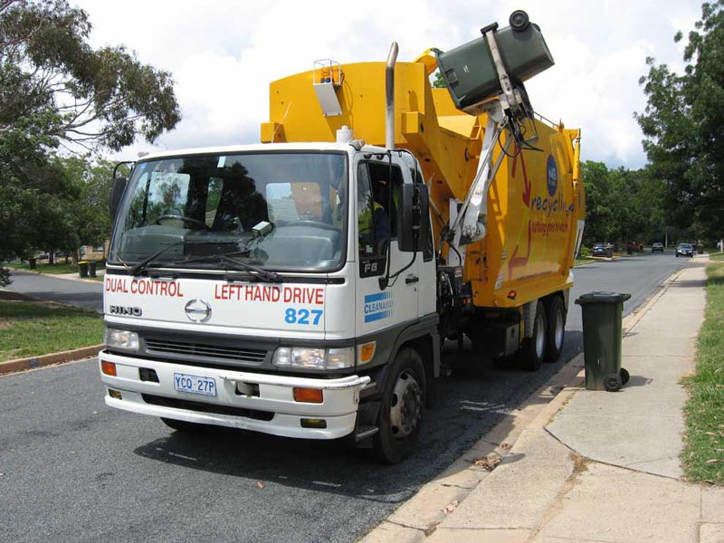
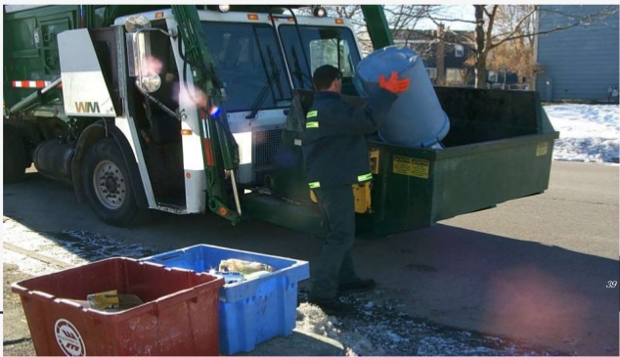
Types of Collection Service
Curb side or Alley method: residences are required to place the solid wastes in containers at the curb/alley during designated collection days.
Backyard method: No collection days are specified, the collection crew simply enter residential backyards and empty owners solid waste storage container into tote barrels for loading into waiting collection vehicle on the street.
Curbside Collection
Backyard Collection

Slide 14
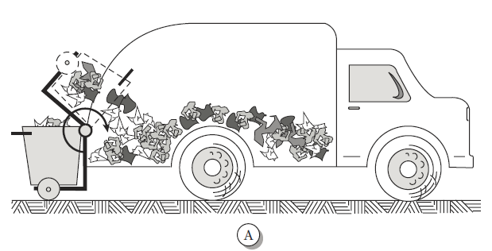
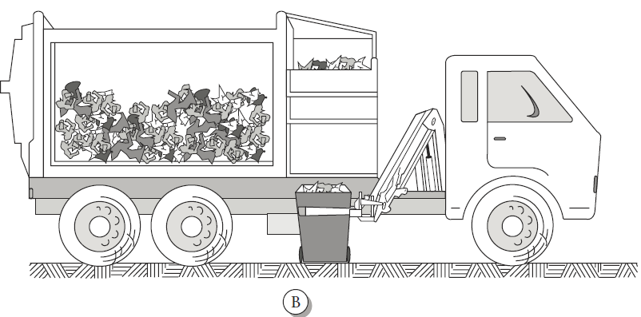
Collection Vehicles
Semiautomated
(B) Fully automated

Slide 15
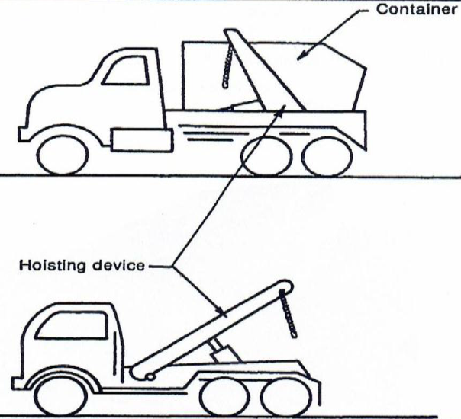
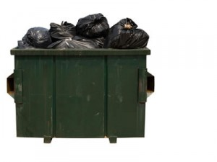
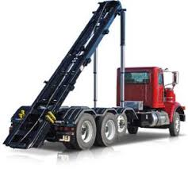
Solid Waste Collection Systems
There are two types of collection systems:
Hauled-container system
Commercial
C&D debris
Stationary-container system
Residential
Commercial
Stationary-container system
Trucks for Hauled-container system
Notes:
C&D = Construction and Demolition

Slide 16
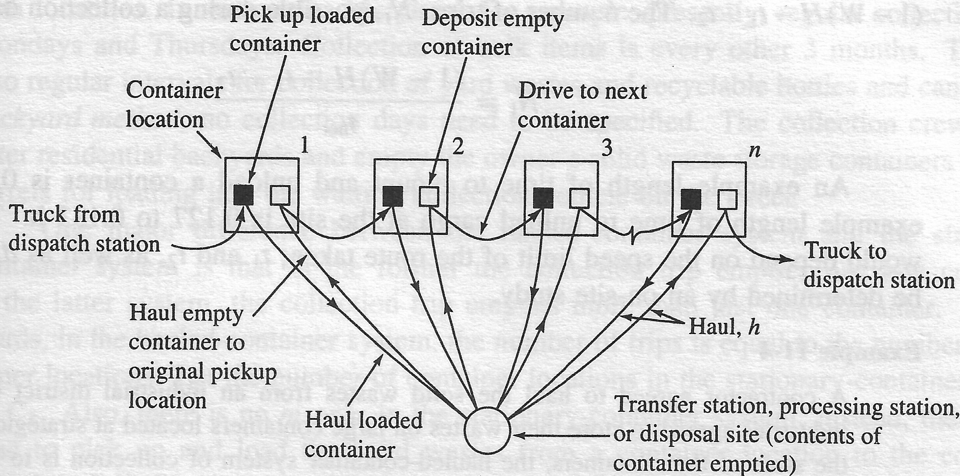
Hauled-Container System
Container with waste is hauled from the collection point to the final point of disposal, processing facility or transfer station (destination point)
In this system, the container is very large, so it is not emptied at the collection point, but is mounted into the collection vehicle and hauled

Slide 17
Hauled-Container System
Analysis of Hauled-Container System
The truck spends a time ‘t₁’ in driving from dispatch station to the first collection point, designated as the container location.
The time taken to mount the container into the collection vehicle is ‘m’
The time spent to unload the solid waste at the destination point is ‘s’
From the destination point the vehicle goes back to the container location and ‘u’ is the time taken to unload the container.
‘h’ is the haul time which is the time taken to drive from the collection point to the destination point and back.
If more than one collection point or location is serviced, then time is spent in driving from one collection point to another. Let ‘d_{l}’ be the average between-collection-point driving time per collection point.

Slide 18
Hauled-Container System
The activities that constitute a trip :
mounting the container,
driving to the destination point,
unloading the cargo,
driving back to the collection point,
unloading the container,
driving between the collection points
u
m
t₁
s

Slide 19
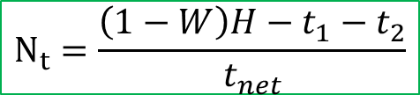
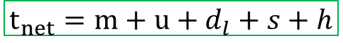
Hauled-Container System
If t_{net} is the on the job time used per trip, then
Let ‘H’ be the total allotted time during a work-day.
Within this allotted time, and let ‘W’ be the fraction of ‘H’ spent on these non-job related activities.
At the end of the working day, the vehicle will also have to spend time ‘t₂’ to drive from the last collection point to the dispatch station.
The net time spent for collection activities is only (1-W)H - t₁- t₂.
The number of trips N_{t} possible during a collection day is:
$$t_{net}=m+u+d_{l}+s+h$$
$$N_{t}=\frac{\left(1−W\right)H−t_{1}−t_{2}}{t_{net}}$$

Slide 20
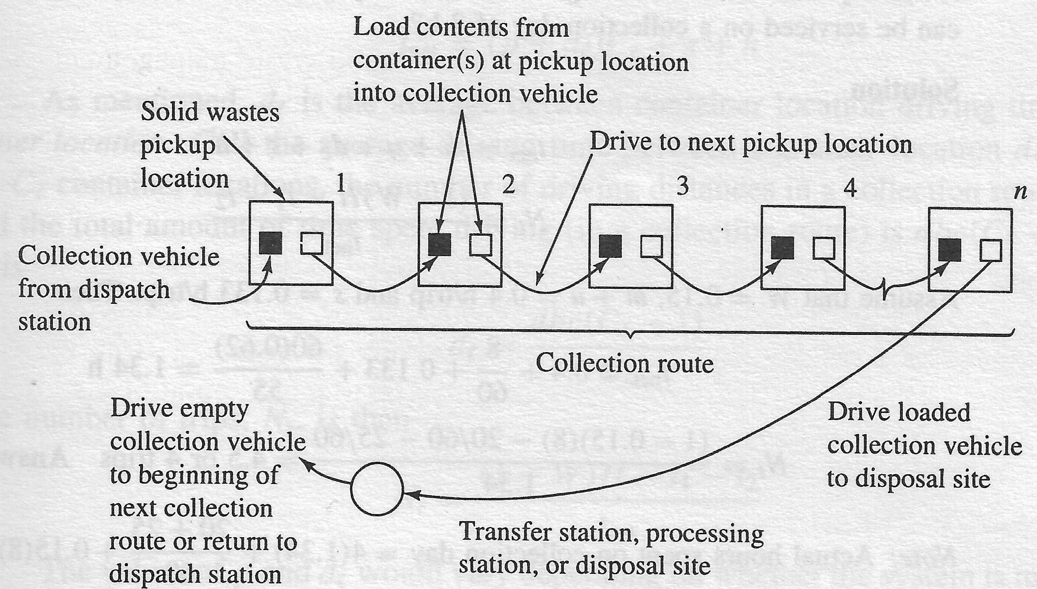
Stationary-Container System
Container with waste is emptied into collection vehicles at the point of collection
Mechanical means (large containers): apartment buildings, large commercial establishments and public parks
Manual means (small containers): residential areas

Slide 21
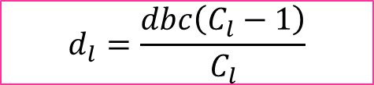
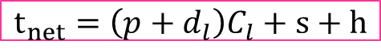
Analysis of Stationary-Container System
Let the number of container locations be C_{l}.
Instead of ‘m’ and ‘u’, there is time to pickup and load the wastes from a container location to the collection vehicle, this time is ‘p’.
Using the meaning for ‘d_{l}’ as average between-container location driving time per container location;
‘s’ is the time spent to unload MSW at the destination point; and ‘h’ is the haul-time; t_{net} is the on-the-job time used per trip.
Let the average driving time between container location ‘dbc’
The number of driving distances in a collection route is C_{l}-1; and total amount of time spent driving (in a collection route) is dbc (C_{l}-1).
Hence,
$$t_{net}=\left(p+d_{l}\right)C_{l}+s+h$$
$$d_{l}=\frac{dbc\left(C_{l}−1\right)}{C_{l}}$$

Slide 22
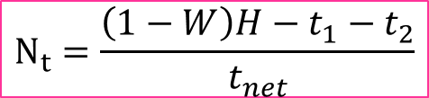
Analysis of Stationary-Container System
The number of trips N_{t} possible during collection day is then
W is the fraction of total allotted time during workday (H) spent on non-job related activities; t₁, t₂ are times to drive from dispatch station to 1st collection point; and from last collection point to dispatch station, respectively.
The value ‘p’ and ‘d_{l}’ would vary depending on whether the system is mechanically (high) or manually loaded (low).
On-site time study must be performed to determine ‘dbc’
Time-studies should be performed for each size of crew; as size of collection vehicle is also a factor in this system.
$$N_{t}=\frac{\left(1−W\right)H−t_{1}−t_{2}}{t_{net}}$$

Slide 23
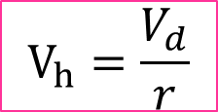
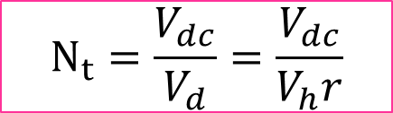
Analysis of Stationary-Container System
If the volume of the refuse as discarded in 1-trip is V_{d} per collection route, and ‘r’ is the compaction ratio, the required volume of the vehicle is:
If the total discarded volume of the solid waste on collection day is ‘V_{dc}’, the total number of trips is:
$$V_{h}=\frac{V_{d}}{r}$$
$$N_{t}=\frac{V_{dc}}{V_{d}}=\frac{V_{dc}}{V_{h}r}$$

Slide 24
Solid Waste Collection Systems
One major difference between the Hauled-container system and Stationary-container system is that in the former, the collection trip empties just one container; whereas in the later system, the collection trip empties more than 1 container.
In the hauled-container system,
number of trips = number of container locations

Slide 25
Definition of Terms in Collection Systems
The activities involved in the collection of solid wastes can be resolved into four unit operations:
Pickup
Haul
At-site
Off-route
Pickup:
For hauled container systems pickup refers to the time spent driving to the next container after an empty container has been deposited, the time spent picking up the loaded container, and the time required to redeposit the container after its contents have been emptied.
For stationary container system, pickup refers to the time spent loading the collection vehicle, beginning with stopping the vehicle before loading the contents of the first container and ending when the contents of the last container to be emptied have been loaded.

Slide 26
Definition of Terms in Collection Systems
Haul:
For hauled container systems, haul represents the time required to reach the location where the contents of the container will be emptied, starting when a container whose contents are to be emptied has been loaded on the truck and continuing through the time after leaving the unloading location until the truck arrives at the location where the empty container is to be deposited. Haul time does not include any time spent at the location where the contents of the container are unloaded.
For stationary container systems, haul refers to the time required to reach the location where the contents of the collection vehicle will be emptied, starting when the last container on the route has been emptied or the collection vehicle is filled and continuing through the time after leaving the unloading location until the truck arrives at the location of the first container to be emptied on the next collection route. Haul time does not include the time spent at the location where the contents of the collection vehicle are unloaded.

Slide 27
Definition of Terms in Collection Systems
At-Site:
The unit operation at-site(s) refers to the time spent at the location where the contents of the container (hauled container system) or collection vehicle (stationery container system) are unloaded (e.g., transfer station or disposal site) and includes the time spent waiting to unload as well as the time spent unloading the wastes from the container or collection vehicle.

Slide 28
Definition of Terms in Collection Systems
Off-Route:
The unit operation off-route (W) includes all time spent on activities that are nonproductive from the point of view of the overall collection operation. Many of the activities associated with off-route times are sometimes necessary or inherent in the operation.
Therefore, the time spent on off-route activities may be subdivided into two categories: necessary and unnecessary.
In practice, however, both necessary and unnecessary off-route times are considered together because-they must be distributed equally over the entire-operation.
Necessary off-route time includes:
Time spent checking in and out in the morning and at the end of the day
Time lost due to unavoidable congestion, and
Time spent on equipment repairs, maintenance, and so on.
Unnecessary off-route time includes:
Time spent for lunch in excess of the stated lunch period;
Time spent on taking unauthorized coffee breaks, talking to friends

Slide 29
Summary Questions
Q1) A contractor agreed to haul the solid wastes from an commercial district of a city. The commercial establishments agreed to store their wastes in large containers located at strategic points. Due to the sizes of the containers, the hauled container system is to be used. Based on a traffic study t₁, t₂, and d_{l} were found to be 20, 25, and 8 min respectively. If the round trip haul distance averaged 60 km at a speed limit of 90 kmph. How many containers can be serviced on a collection day of 8 hrs., assuming 15% of work time is lost.

Slide 30
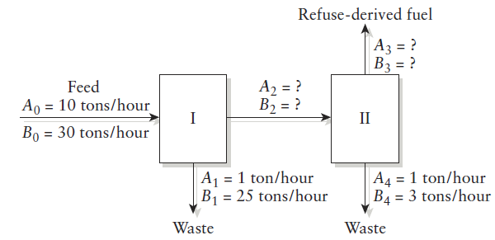
Summary Questions
Q2) A solid waste processing plant has two classifiers that produce a refuse-derived fuel (RFD) from a mixture of organic (A) and inorganic (B) refuse. A portion of the plant schematic and the known flow rates are shown in the Figure.
What is the flow of A and B from Classifier I to Classifier II [Q_{A2} and Q_{B2}]
What is the composition of the Classifier II exit stream [Q_{A3} and Q_{B3}]?
What is the purity of the RFD and the recovery of component A?

